Slide 1
Comparing Cost-Effectiveness of Annual vs. Semi-Annual Mass Drug Administration for Helminth Infections in High Prevalence Settings
Selam Melese
Natalie Olson
HPM 573
Yale School of Public Health

Slide 2
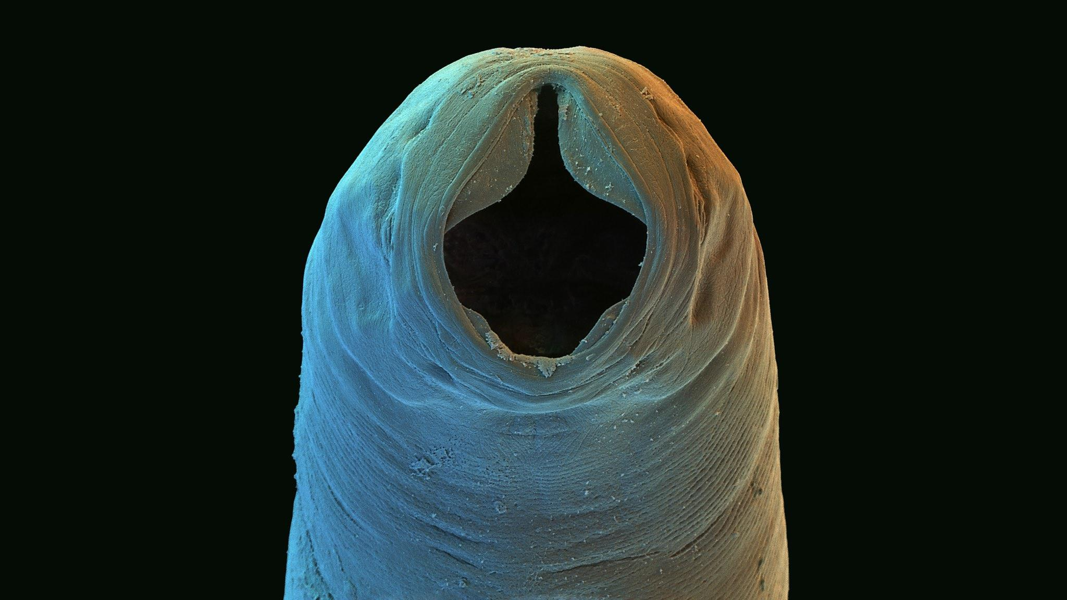
Necator americanus
&
Ancylostoma duodenale
Selam Melese
Natalie Olson
Notes:
Neglected Tropical Diseases (NTDs) are a group of parasitic and bacterial diseases that cause substantial illness for more than one billion people globally. Affecting the world's poorest people, NTDs impair physical and cognitive development, contribute to mother and child illness and death, make it difficult to farm or earn a living, and limit productivity in the workplace. As a result, NTDs trap the poor in a cycle of poverty and disease.

Slide 3
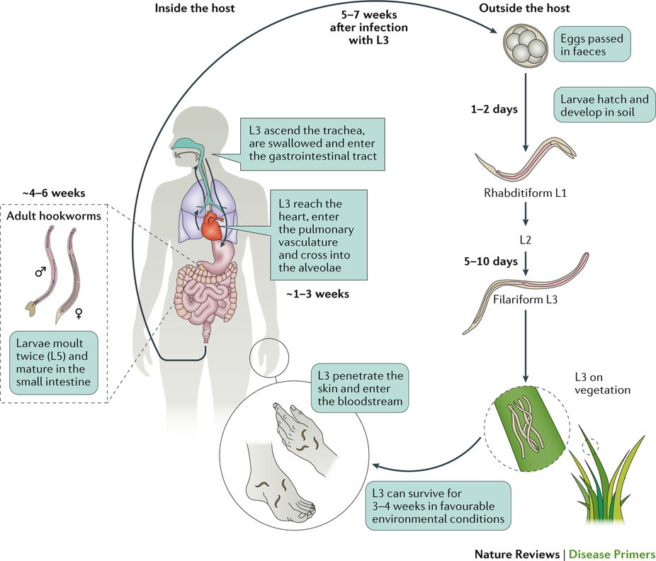
Soil-Transmitted Helminths (STH)
Neglected Tropical Disease (NTD)
Iron-deficiency anemia
Stunted growth & development
Impaired cognitive function
& educational attainment
Reduced economic output
Selam Melese
Natalie Olson
Notes:
NTD Status → Interventions must be aggressively cost-effective due to low resource availability

Slide 4
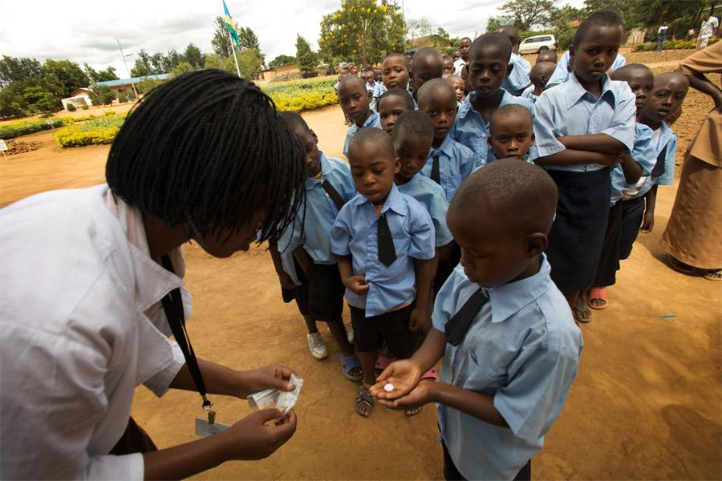
Mass Drug Administration (Albendazole)
Selam Melese
Natalie Olson

Slide 5
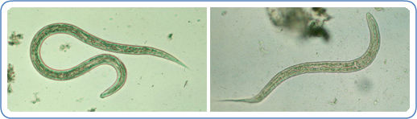
How frequently should Albendazole mass drug administration (MDA) campaigns be implemented for controlling hookworm infection in a community?
Standard Practice: Annual mass drug administration with albendazole
Modeled Alternative: Semi-Annual mass drug administration with albendazole
Outcomes of interest:
Cost-effectiveness (cost of treatment vs. DALY’s averted)
Decreased cumulative infection duration (across multiple infections)
Selam Melese
Natalie Olson
Notes:
Rather than comparing strategy against no intervention, comparing against standard practice of annual MDA

Slide 6
Model Assumptions & Limitations
Limitations:
Does not account for environmental transmission dynamics
Does not reflect genetic resistance to infection among population
Does not reflect hookworm population dynamics (assumes constant transmission rate)
Highly variable rate of parasite clearance between individuals
Assumptions:
Constant rate of environmental transmission (adults as reservoir population for parasite)
Homogeneous susceptibility to infection
Homogeneous reproductive rate & egg production of hookworm females
Constant natural recovery rate
Selam Melese
Natalie Olson
Notes:
ASSUMING HOMOGENEITY
**MODEL NOT CALIBRATED

Slide 7
Model Parameters
Parameter | Symbol | Rate | Reference
Transmission Rate | 𝜆1 | 6.5 per 100 person-years | Jiraanankul et al. 2011
Natural Recovery Rate | 𝜆4 | 1-4 years (2-year average) | Anderson et al. 2014⁵
MDA Coverage Rate | 𝜆2 | 56.2% | Bartsch et al. 2016³
Albendazole Effectiveness | 𝜆3 | 78.4% | Bartsch et al. 2016³
Albendazole Treatment Cost | - | $0.50/child | Bartsch et al. 2016³
DALY Estimate (Utility) | - | 0.802 | Bartsch et al. 2016³
Selam Melese
Natalie Olson

Slide 8
Model States
𝜆1 = Transmission Rate
𝜆2 = Treatment Coverage Rate
𝜆3 = Parasite Clearance Rate with Albendazole
𝜆4 = Background Recovery Rate
𝜆1
𝜆2
Receiving Albendazole Treatment
Well (Susceptible)
Infected
𝜆4
𝜆3
Selam Melese
Natalie Olson

Slide 9
Sensitivity Analysis
Cost → Gamma Distribution
Utility → Beta Distribution
Discount Rate → One-way sensitivity analysis
Other parameters → No need for calibration due to model assumptions ¯
\_(ツ)_/¯
Selam Melese
Natalie Olson

Slide 10
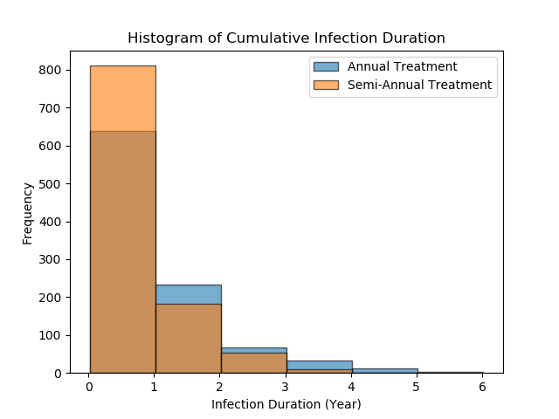
Under Normal Conditions
(Low Coverage)
56.2% of Infected Children Treated
Average decrease in infection duration and 95% CI: -0.26 (-0.39, -0.14)
Selam Melese
Natalie Olson
Notes:
Most durations less than 1 year
GREATER proportion of simulated patients in semi-annual with duration less than 1 year (compared with annual)
LOWER proportion of simulated patients in semi-annual with durations greater than 1 year

Slide 11
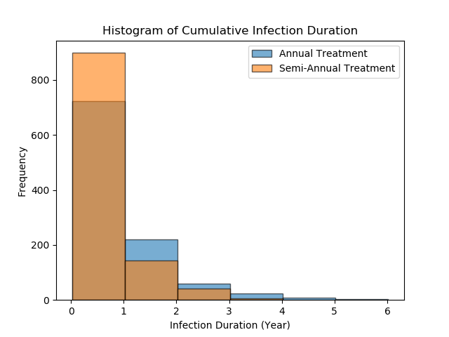
Under Ideal Conditions
(High Coverage)
75% of Infected Children
Treated
(WHO Healthy People 2020 Development Goals)
Selam Melese
Natalie Olson
Notes:
Pushes infection duration down for both annual & semi-annual

Slide 12
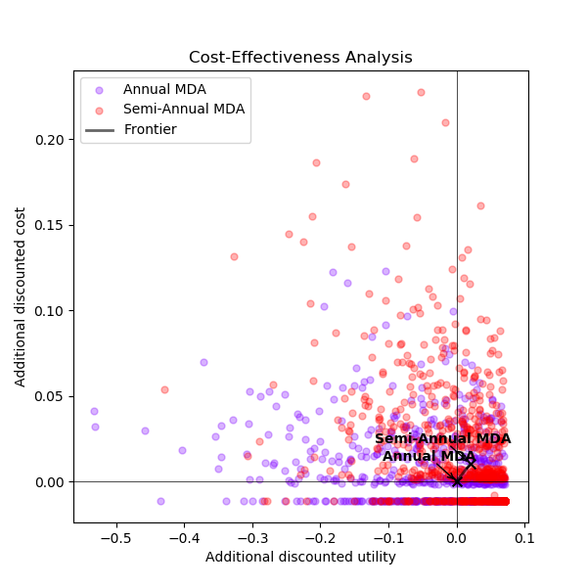
Cost-Effectiveness Analysis
Average increase in discounted cost :
$0.01 (95% CI: $0.01, $0.01) per individual treatment
Average increase in discounted utility and 95% CI:
0.02 DALYs (0.01, 0.03) per individual
Selam Melese
Natalie Olson
Notes:
The cost of treatment is $.50 and it will cost an additional $0.01 per treatment move to semi-annual treatment instead of annual treatment. That may seem like a small amount, but if you multiply it by the entire percentage of the population that is being treated twice a year, it adds up quickly
0.02 Disability Adjusted Life Years is equivalent to approximately 7 days per person that is gained over their lifetime.
Calculated by using hookworm related anemia as there are no disability weights directly available for hookworm (can also use cognitive impairment, but that is rare and only in heavy intensity infections so we decided not to include it)
ICER = cost of treatment-cost of control/effectiveness of treatment-effectiveness of control = ((.5*2)*1000*56.2%)-(.5*1000*56.2%)/(.02*1000) = 562-281/20 = $14.05

Slide 13
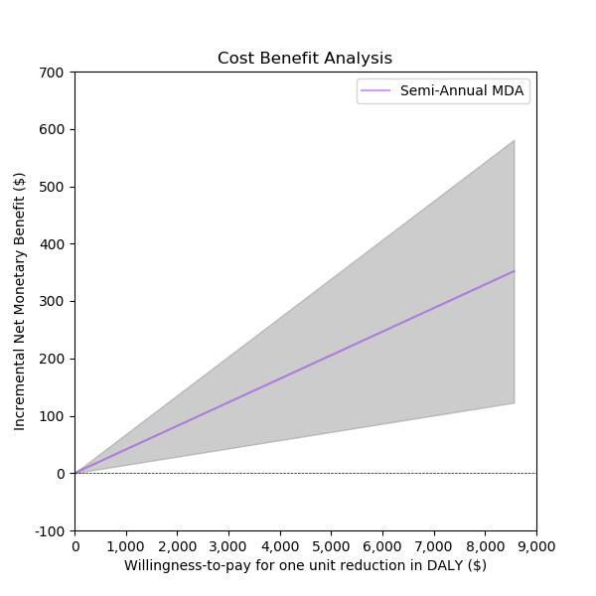
Cost-Benefit Analysis
Willingness-to-pay per DALY averted extrapolated from per capita GDP of Brazil ($8,649.95)
Selam Melese
Natalie Olson
Notes:
The NMB is around $350, which is way below the per capita GDP.
The ICER that we calculated was also drastically lower than the per capita GDP.
Because both the ICER & NMB are below per capita GDP, implementing a semi-annual treatment instead of annual is cost effective practice.

Slide 14
CONCLUSIONS
Semi-annual MDA decreases average expected cumulative infection duration by 3.12 months per individual compared with annual MDA.
Semi-annual MDA is slightly more expensive but slightly more effective than annual MDA.
Semi-annual MDA should be implemented whenever feasible & if funds are available but annual MDA remains a highly cost-effective alternative.
Average expected cumulative infection duration is sensitive to changes in the coverage parameter.
Selam Melese
Natalie Olson
Notes:
Coverage impacts duration of infection → possible next step

Slide 15
References
1. Loukas A, Hotez PJ, Diemert D, Yazdanbakhsh M, McCarthy JS, Correa-Oliveira R, Croese J, Bethony JM. Hookworm infection. Nature Reviews Disease Primers 2016;2:16088.
2. Brooker S, Bethony J, Hotez PJ. Human Hookworm Infection in the 21(st) Century. Advances in parasitology 2004;58:197-288.
3. Bartsch SM, Hotez PJ, Hertenstein DL, Diemert DJ, Zapf KM, Bottazzi ME, Bethony JM, Brown ST, Lee BY. Modeling the economic and epidemiologic impact of hookworm vaccine and mass drug administration (MDA) in Brazil, a high transmission setting. Vaccine 2016;34:2197-206.
4. Jia T-W, Melville S, Utzinger J, King CH, Zhou X-N. Soil-Transmitted Helminth Reinfection after Drug Treatment: A Systematic Review and Meta-Analysis. PLOS Neglected Tropical Diseases 2012;6:e1621.
5. Anderson R, Truscott J, Hollingsworth TD. The coverage and frequency of mass drug administration required to eliminate persistent transmission of soil-transmitted helminths. Philosophical Transactions of the Royal Society B: Biological Sciences 2014;369:20130435.
6. Njenga SM, Mwandawiro CS, Muniu E, Mwanje MT, Haji FM, Bockarie MJ. Adult population as potential reservoir of NTD infections in rural villages of Kwale district, Coastal Kenya: implications for preventive chemotherapy interventions policy. Parasites & Vectors 2011;4:175.
7. Jiraanankul V, Aphijirawat W, Mungthin M, Khositnithikul R, Rangsin R, Traub RJ, Piyaraj P, Naaglor T, Taamasri P, Leelayoova S. Incidence and Risk Factors of Hookworm Infection in a Rural Community of Central Thailand. The American journal of tropical medicine and hygiene 2011;84:594-8.
8. Leech AA, Kim DD, Cohen JT, Neumann PJ. Use and Misuse of Cost-Effectiveness Analysis Thresholds in Low- and Middle-Income Countries: Trends in Cost-per-DALY Studies. Value in Health 2018.
9. GDP Per Capita (Current US $). 2016.
10. Anderson RM, Turner HC, Truscott JE, Hollingsworth TD, Brooker SJ. Should the Goal for the Treatment of Soil Transmitted Helminth (STH) Infections Be Changed from Morbidity Control in Children to Community-Wide Transmission Elimination? PLOS Neglected Tropical Diseases 2015;9:e0003897.
11. Meyer-Rath G, van Rensburg C, Larson B, Jamieson L, Rosen S. Revealed willingness-to-pay versus standard cost-effectiveness thresholds: Evidence from the South African HIV Investment Case. PLoS ONE 2017;12:e0186496.
12. Ziegelbauer K, Speich B, Mäusezahl D, Bos R, Keiser J, Utzinger J. Effect of sanitation on soil-transmitted helminth infection: systematic review and meta-analysis. PLoS medicine 2012;9:e1001162.
13. Strunz EC, Addiss DG, Stocks ME, Ogden S, Utzinger J, Freeman MC. Water, sanitation, hygiene, and soil-transmitted helminth infection: a systematic review and meta-analysis. PLoS medicine 2014;11:e1001620.
Selam Melese
Natalie Olson

Slide 16
